Slide 1
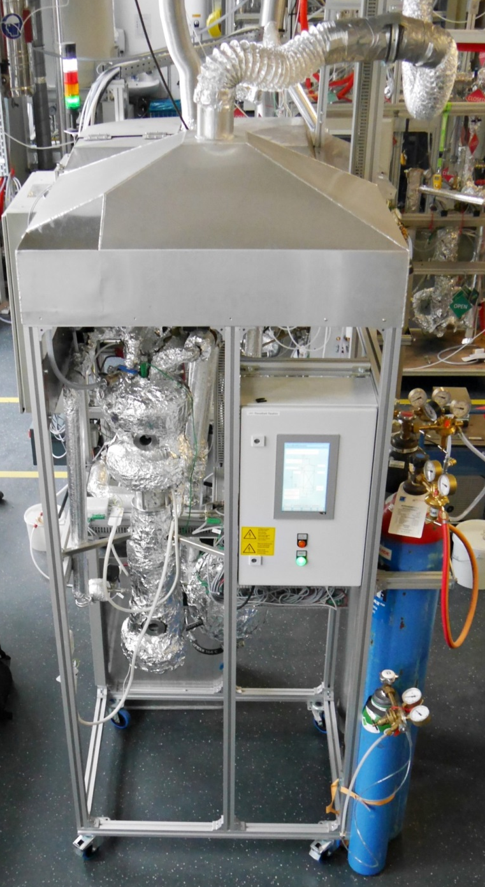

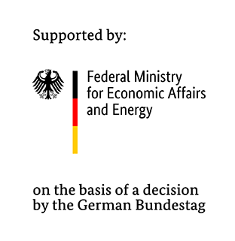
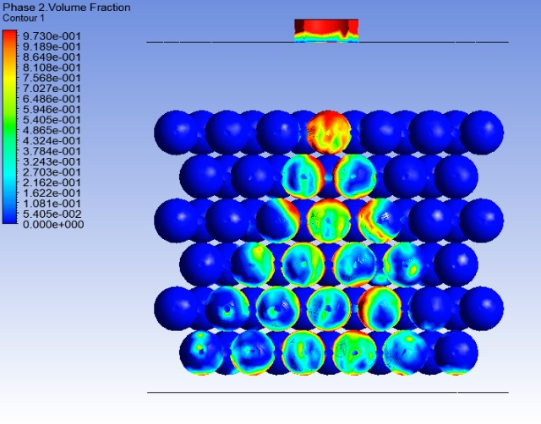
Biological Methanation in a Trickle-Bed Reactor
26th EUROPEAN BIOMASS CONFERENCE
Tobias Weidlich
Chair of Energy Process Engineering
Friedrich-Alexander-University Erlangen-Nürnberg
Notes:
Es fehlen die slides!
Ein Bild vom Flüssigkeitsverteiler,
Projektpartner später
Bidl trickles (Julian nix)

Slide 2
1. Biological Methanation
2. Lab Scale Trickle-Bed Reactor
3. The Project Orbit – more than a up-scale
4. Conclusion
Notes:
20/40

Slide 3
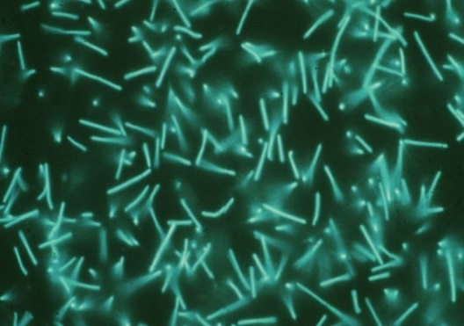
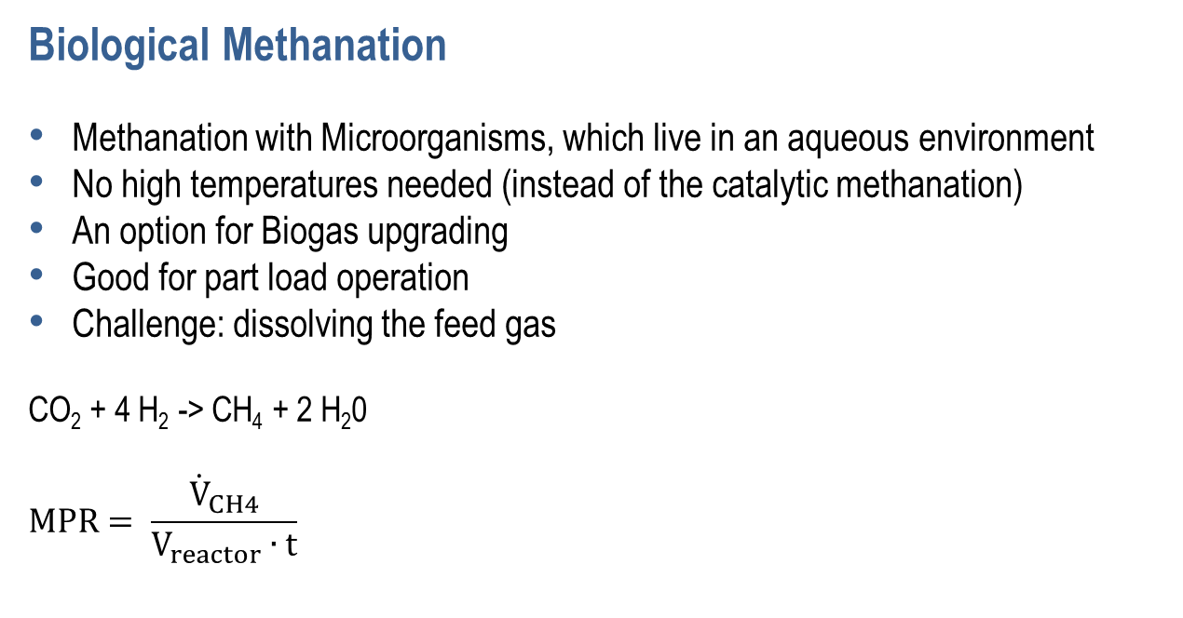
Biological Methanation
Methanation with Microorganisms, which live in an aqueous environment
No high temperatures needed (instead of the catalytic methanation)
An option for Biogas upgrading
Good for part load operation
Challenge: dissolving the feed gas
CO₂ + 4 H₂ -> CH₄ + 2 H₂0
$$MPR= \frac{{\dot{V}}_{CH4}}{V_{reactor}∙t}$$
Source: Institute of Microbiology and Archaea Centre, University of Regensburg
Notes:
00:40/1:40

Slide 4


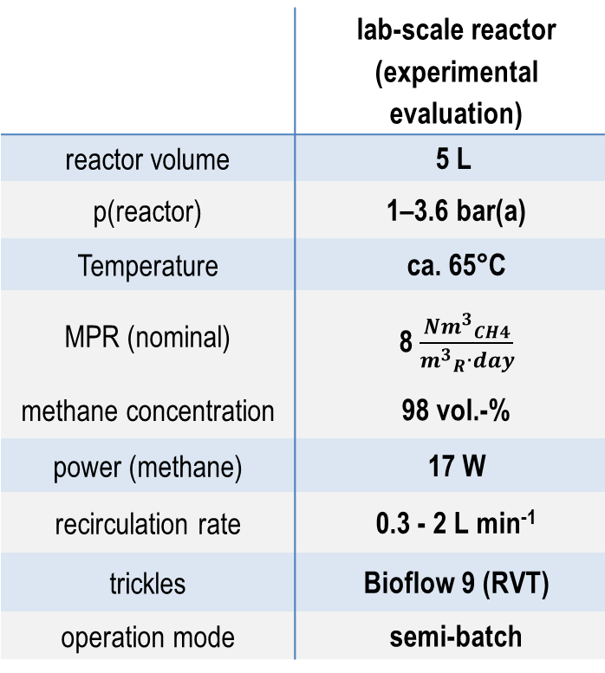
Data Of The Lab-Scale Trickle-Bed Reactor
 | lab-scale reactor (experimental evaluation)
reactor volume | 5 L
p(reactor) | 1–3.6 bar(a)
Temperature | ca. 65°C
MPR (nominal) | 8 $\frac{{Nm^{3}}_{CH4}}{{m^{3}}_{R}∙day}$
methane concentration | 98 vol.-%
power (methane) | 17 W
recirculation rate | 0.3 - 2 L min⁻¹
trickles | Bioflow 9 (RVT)
operation mode | semi-batch
lab-scale reactor
Notes:
1:40/2:10

Slide 5
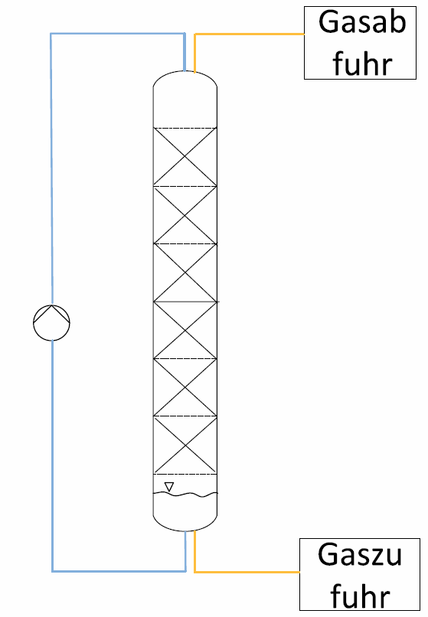
Results Of The 5 Liter Trickle-Bed Reactor
Pressure dependence was proved
  higher pressure improves the methane production
Dependence on the recirculation rate was examined
The optimization of the recirculation rate would increase the reactor performance due to better dissolving
product gases
reactant gases
Methane production rate with high variations
  Nearly impossible to find the perfect recirculation rate
  Reason for variations: steel?
Notes:
2:10/3:50

Slide 6







New Project ORBIT – More Than An Up-Scale
Project partners
Focus of the project:
Simulation of the trickle-bed reactor with ASPEN Plus
Construction of a 50-liter trickle-bed reactor with an optimized reactor design
Fully automated and CE-certified reactor
Experiments in Nuremberg und Regensburg
Trickle studies and selection of microorganisms in Regensburg (OTH & UR)
Integration of the reactor at the PTG-Location Ibbenbüren (electrolyzer and DP16 gas grid)
CFD-Simulation for further upgrade
Notes:
3:50/4:50

Slide 7
Reactor Concept
Option A
High liquid volume
Trickle bed for the absorption, not for the reaction
Useful if:
Amount of microorganisms is the bottle neck (absorption goes quickly)
Option B
Large trickle bed
Trickle bed for the absorption and for the reaction
Useful if:
Absorption is the bottle neck (reaction goes quickly)
Notes:
Counterflow
4:50/6:30

Slide 8
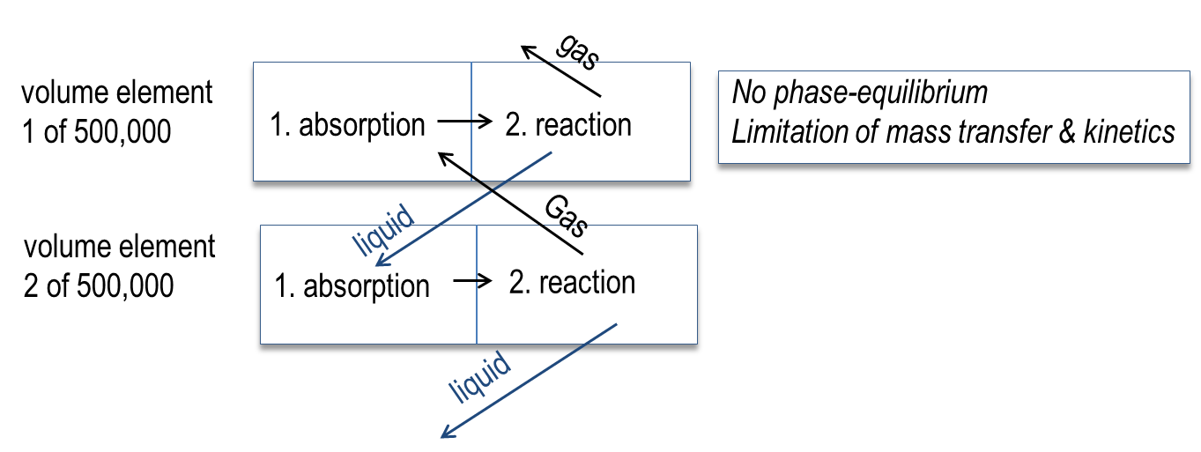
Calculation Of The Best Height-To-Diameter Ratio (h/d)
Development of a differential elements model (MATLAB):
500.000 horizontal differential elements
For each horizontal element: first absorption and then reaction
Mass transfer coefficient of the absorption is calculated
Reaction kinetics are estimated
Influences are analyzed by a parametric study
Result
Nearly no influence of h/d

Slide 9
Results Of The MATLAB-Model
product gases
reactor height in m
reactant gases
methane concentration
higher pressure leads to a better performance
a high concentration of methane is difficult to reach
Notes:
6:45/8:00

Slide 10
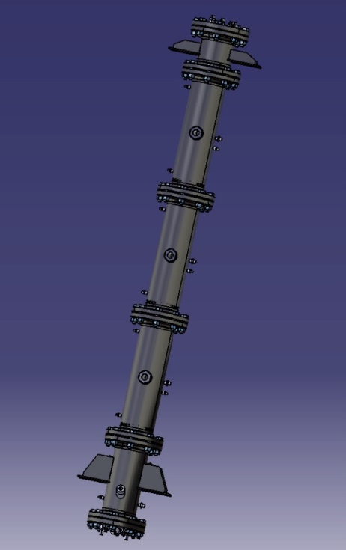
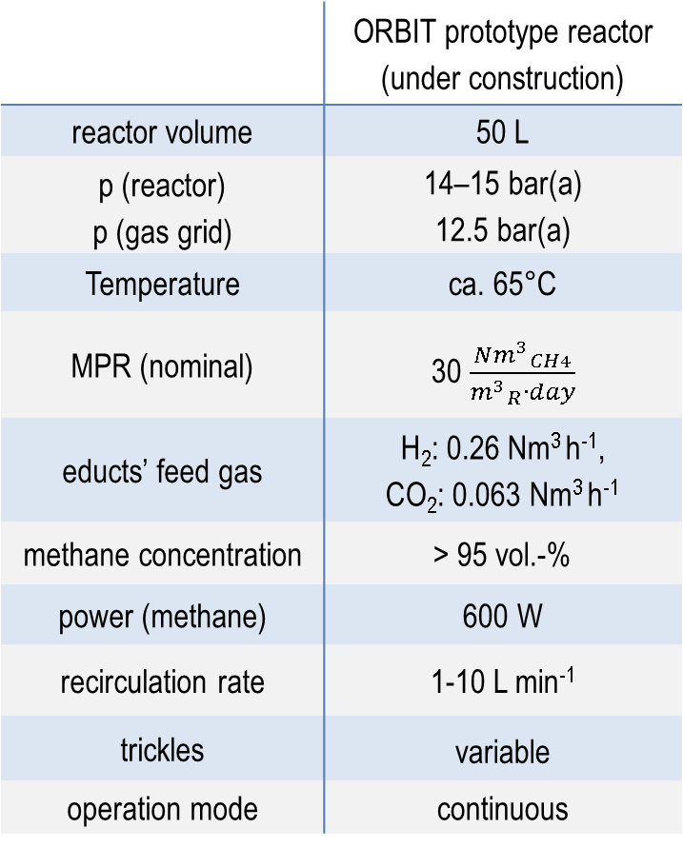
Data Of The 50-Liter Trickle-Bed Reactor
 | ORBIT prototype reactor (under construction)
reactor volume | 50 L
p (reactor) p (gas grid) | 14–15 bar(a) 12.5 bar(a)
Temperature | ca. 65°C
MPR (nominal) | 30 $\frac{{Nm^{3}}_{CH4}}{{m^{3}}_{R}∙day}$
educts’ feed gas | H₂: 0.26 Nm³ h⁻¹, CO₂: 0.063 Nm³ h⁻¹
methane concentration | > 95 vol.-%
power (methane) | 600 W
recirculation rate | 1-10 L min⁻¹
trickles | variable
operation mode | continuous
CAD-construction of the ORBIT-reactor
Notes:
8.00/8:20

Slide 11

Reactor Construction
Total height | 2500 mm
Nominal width / Pressure stage | DN150 / PN16
Reaction zone | in 3 identical parts
Length of trickle zone per part | 550 mm
h/d-ratio per part | 3.5/1
Volume of the reactor | 52 L
Volume of trickle zone | 35 L
Goal: Product quality of 95% methane
Notes:
8:29/8:40

Slide 12
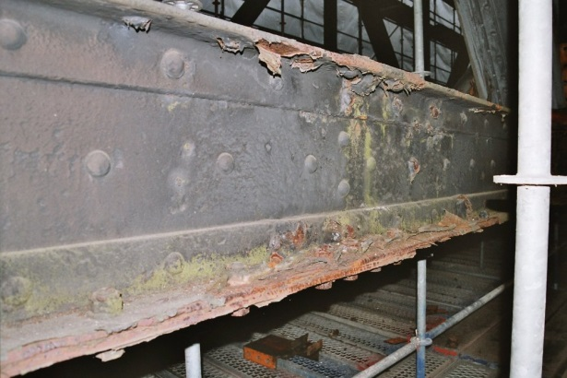
The Selection Of The Reactor Material
Microorganisms live in a seawater-liquid with additives
Challenges
  Steel corrosion pitting
  Molecules from the steel can dissolve into the medium which poisons or interferes with the microorganisms
No known study about this topic so far
Very First Experimental Results – still to prove
Steel | Corrosion | Effect on microorganisms
V2A (1.4541) | high | No negative effect
V4A (1.4404) | slow | small negative effect
Duplex (1.4462) | no | very small negative effect
data: Institute of Microbiology and Archaea Centre, University of Regensburg
Notes:
8:40/10:20

Slide 13
Conclusion
A 5-liter lab-scale trickle-bed reactor is already running to get experience and experimental results
Pressure dependence was proved, recirculation shows too high variations
An 50-liter upscale is under construction
The MATLAB-model shows
  that a high methane-purity is hard to get
  the h/d ratio is not important
  high pressure improved the methanation
The influence of different steels for the Microorganisms is still to prove
Thank you for listening!
Notes:
10:20/11.00

Slide 14
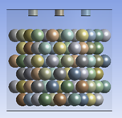
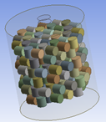
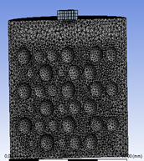
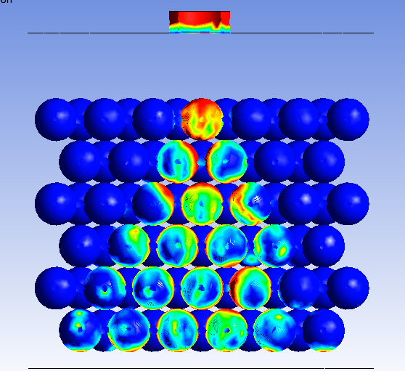
Backup: CFD-Simulation
Goals:
Mapping of the hydrodynamics
Mapping of the absorption
Mapping of the biological reaction
spherical trickles
cylindrical trickles
mesh
simulation results

Slide 15
Backup: Proof Of The Best h/d Ratio
Necessary reactor Volume to produce 2,500 Nm_{CH4}³/day
Reasonable calculation
3 times better mass transfer
10 times worse reaction rate
necessary reactor volume in liter
Reactor diameter in cm

Slide 16
Backup: Pressure Dependence Of The Lab-Scale Reactor

